Slide 1
Battle of Neighborhoods
Applied Data Science Capstone Final Project
Rahil Sharma

Slide 2
Oklahoma:The cowboy state of US
Oklahoma City is the capital of the U.S. state of Oklahoma. It's known for its cowboy culture and capitol complex, surrounded by working oil wells. The reflecting pool and empty glass and bronze chairs of the Oklahoma City National Memorial recall the victims of the 1995 bombing of the Alfred P. Murrah Federal Building. The Survivor Tree, an American elm nearly destroyed in the attack, is also part of the memorial.
Its residents are known as Oklahomans (or colloquially, "Okies"), and its capital and largest city is Oklahoma City.
It happens to be the 28th most populous state in the USA.

Slide 3
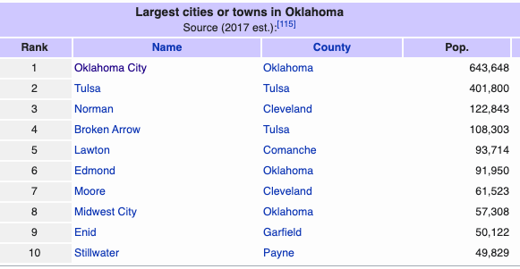
Oklahoma happens to be quite a big state with close to 78 Counties and 597 incorporated municipalities.
In Oklahoma, cities are all those incorporated communities which are 1000 or more in population and
are incorporated as cities. Towns are limited to town board type of municipal government.
The image below shows the biggest cities with their approximate populations :

Slide 4
PROBLEMS:
TO FIND THE ANSWERS TO THE QUESTIONS GIVEN BELOW:
WHICH IS THE COUNTIES WITH THE MOST NUMBER OF CITIES/AREA CODES
IN OAKLAHOMA.
WHICH IS THE BEST LOCATION IN OAKLAHOMA TO FIND INDIAN CUISINE.
THROUGH THIS CODE YOU CAN ALSO FIND ANY TYPE OF EATING OUTLET IN
OKLAHOMA CITY OF YOUR CHOICE.
WHICH IS THE PLACE WHERE IT IS DIFFICULT TO FIND AN INDIAN
RESTAURANT.
5. WHICH IS THE BEST PLACE TO STAY IF YOU PREFER INDIAN CUSINE.

Slide 5
DATA SECTION
FOR THIS PROJECT WE HAVE USED THE FOLLOWING DATA SETS
OKLAHOMA STATE DATASET WHICH CONTAINS THE LIST OF THE AREA CODES,COUNTIES AND CITIES.
DATA SOURCE: https://www.zipcodestogo.com/Oklahoma/
DESCRIPTION: THIS DATASET CONTAINS THE INFORMATION ABOUT AREA CODES, COUNTIES AND CITIES. THIS IS A COMPARITIVELY LARGE DATASET CONSISTING OF CLOSE TO 773 DIFFERENT AREA CODES.
2. INDIAN RESTAURANTS OR ANY OTHER CUISINE RESTURANT OF YOUR PREFERENCE IN EACH COUNTY OF OKLAHOMA CITY.
DATA SOURCE : FOURSQUARE API
DESCRIPTION: BY USING THIS API WE WILL GET ALL THE VENUES IN EACH NEIGHBOURHOOD. WE CAN FILTER THESE VENUES TO GET ONLY INDIAN RESTAURANTS.
3. OKLAHOMA CITY DATABASE WITH THEIR RESPECTIVE COUNTIES AND ZIP CODES
DATA SOURCE: https://www.ciclt.net/sn/clt/capitolimpact/gw_ziplist.aspx?FIPS=40109
DESCIPTION: BY USING THIS DATASET WE ARE TRY STEAMLINE OUR SEARCH

Slide 6
MTHODOLOGY:
We need to begin by finding a proper dataset for the state of Oklahoma which can be
found on https://www.zipcodestogo.com/Oklahoma/ . Once we have found the database
we can extract the data from the url mentioned above using the request command.
Alternatively you can also copy the data from the website to a csv file or a Microsoft Excel
file and then read the file into and create a database for it.
2. Once the database has been created we will then import the geophy library and add
the columns latitudes and longitudes into the database.
3. We will find all venues for each neighbourhood using Foursquare API.
4. We will then filter out all venues with Indian restaurant for further analysis.
5. Next using Foursquare API, we will find the Information about the Indian Restaurants.
Based on the above analysis we will be able to also predict which of the areas in the city of
Oklahoma do not have any Indian restaurants.

Slide 7
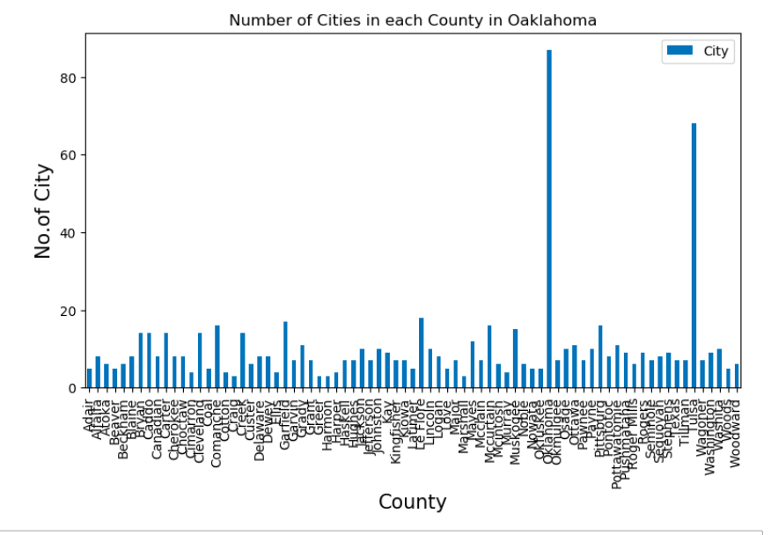
CONCLUSIONS
(ANSWER TO OUR QUESTION STATED)
From the following graph we can predict that Oklahoma City (County) has the highest number of Cities and Area codes in it.

Slide 8
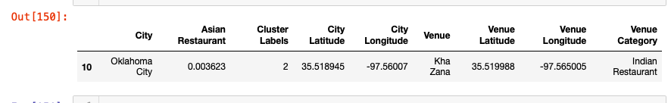
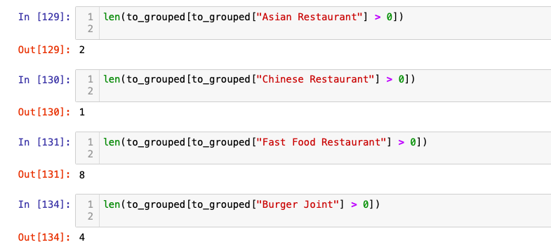
Oklahoma City is the best place for finding good restaurants.Kha Zana is the best Indian Restaurant in Oklahoma City.
Through this code based on the cluster data we have we can find any type of cuisines there in Oklahoma City.
As shown in the screenshot we can get information on any type of restaurant in Oklahoma.

Slide 9
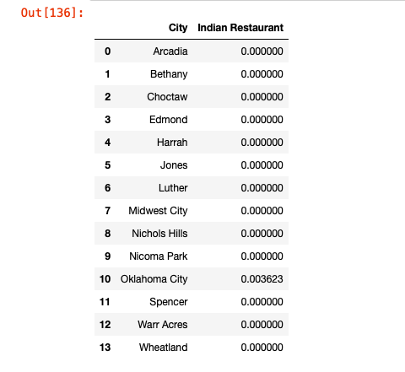
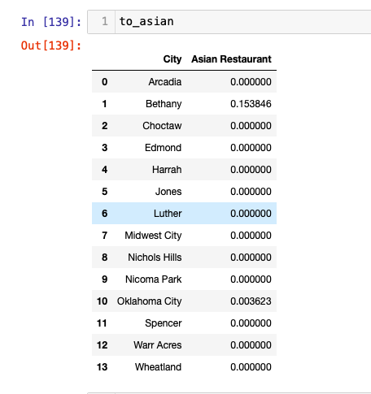
Shown below is the screenshot which shows all the areas where you can find an Indian Restaurants.
Similarly in the other screenshot it gives a result of the areas where you can find an Asian Restaurant.

Slide 10
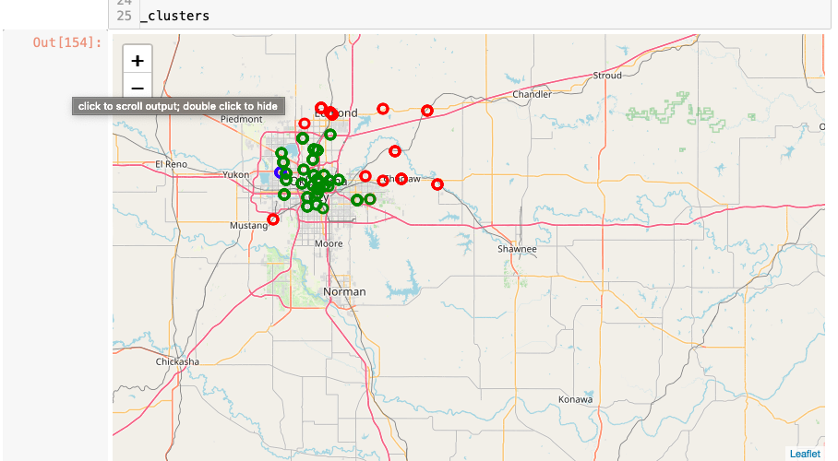
From the above screenshots and the program we have learnt that Oklahoma City(County) would be a
preferable place to live if you prefer Indian Cusine.

